Slide 1


Slide 2
Introduction
Financial statement analysis is a useful tool for both external and internal users as they make decisions about a company or for a company.
Management uses financial statements to access the adequacy of cash flow to pay operating expenses, the efficient use of company resources, and how to improve the overall performance of the company.

Slide 3
Users
Bankers and other lenders: Debt-to-equity
Owners and managers: Gross margin
Credit managers: Quick ratio of customers
Shareholders: P/E or P/EBITDA

Slide 4
AUDITS
Intra Firm & Inter Firm Comparison
Intra firm analysis compares the performance of different units of the same firm.
Inter firm analysis compares financial variables of two or more firms to get an idea of their relative competitive position.

Slide 5
Vertical Analysis
Vertical analysis compares financial statements of different companies and financial statements of the same company across time after controlling for differences in size.
When comparing companies of different sizes, it is useful to standardize the
statements.

Slide 6
Common-Size Statements
All items have been restated as a percentage of a selected item on the statements.
Remove size as a relevant variable in ratio analysis.
Used to compare companies that make similar products.
Used to compare the same company across years.

Slide 7
Balance Sheet - Vertical
 | 2010 | % | 2009 | %
Cash | Rs.6,500,000 | 14.0% | Rs.5,500,000 | 14.9%
Accounts Receivable | 6,500,000 | 14.0 | 6,000,000 | 16.2
Inventory | 11,250,000 | 24.2 | 10,750,000 | 29.1
Prepaid Insurance | 1,250,000 | 2.7 | 1,500,000 | 4.1
Total Current Assets | 25,500,000 | 54.8% | 23,750,000 | 64.2%
Long-term Investments | 5,500,000 | 11.8 | 3,750,000 | 10.1
Land | 10,000,000 | 21.5 | 8,750,000 | 23.6
Property and Equipment | 10,750,000 | 23.1 | 4,750,000 | 12.8
Accumulated Depreciation | (5,250,000) | (11.3) | (4,000,000) | (10.8)
Total Assets | 46500,000 | 100% | 37,000,000 | 100%
Accounts Payable | 3,000,000 | 6.5% | 2,500,000 | 6.8%
Payroll Payable | 500,000 | 1.1 | 400,000 | 1.1
Taxes Payable | 500,000 | 1.1 | 450,000 | 1.2
Total Current Liabilities | 4,000,000 | 8.7% | 3,350,000 | 9.1%
Notes Payable | 5,000,000 | 10.8 | 4,000,000 | 10.8
Capital Stock | 25,000,000 | 53.8 | 20,000,000 | 54.1
Retained Earnings | 12,500,000 | 26.9 | 9,650,000 | 26.1
Total Liabilities and Stockholders’ Equity | 46,500,000 | 100% | 37,000,000 | 100%
All asset accounts are stated as a percentage of total assets.

Slide 8
Working Capital
Working capital is defined as the excess of current assets over current liabilities and is a measure of an entity’s liquidity, or its ability to meet its immediate financial obligations.

Slide 9
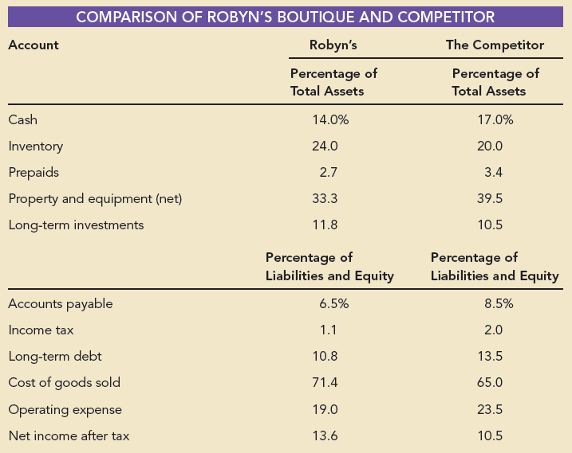
An important use of common-size financial statements is to compare companies that are in similar lines of business but are of different sizes. This table shows such a comparison.

Slide 10
Liquidity Ratios (Can we pay bills?)
Liquidity ratios assess the ability of a company
to meet its immediate or short-term financial obligations.
Current Ratio
Acid-Test Ratio
Inventory Turnover Ratio
Accounts Receivable Turnover

Slide 11
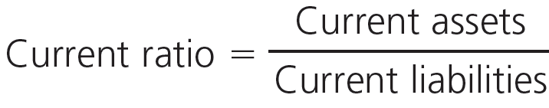
Current Ratio

Slide 12
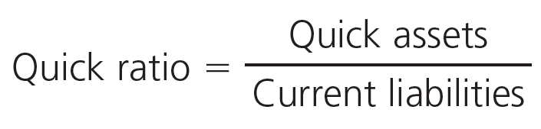
Acid-Test Ratio

Slide 13
CONVERSION PERIOD RATIOS
Conversion Period Ratio:
indicates the average time it takes in days to convert certain current assets and current liability accounts into cash
Operating Cycle:
time it takes to purchase, produce, and sell the venture’s products plus the time needed to collect receivables if the sales are on credit
Cash Conversion Cycle:
sum of the inventory-to-sale conversion period and the sales-to-cash conversion period less the purchase-to-payment conversion period

Slide 14
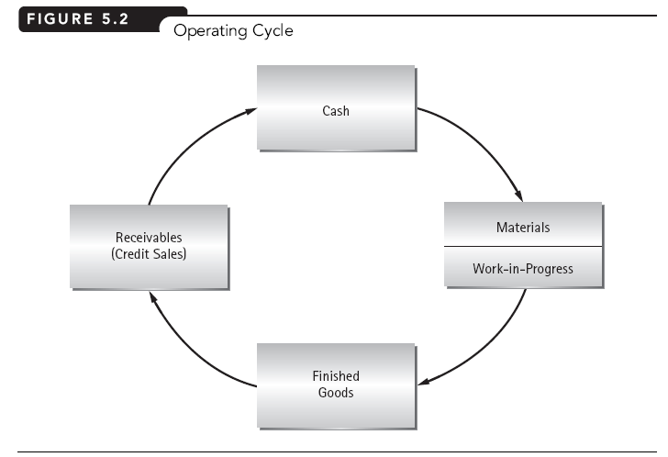

Slide 15
Days in Inventory
Days in Inventory (DII) = Average Inventory
COGS/day

Slide 16

Inventory Turnover Ratio
Or, Inventory Turnover Ratio = 360
DII

Slide 17
MEASURING CONVERSION TIMES
Average Collection Period / Days sales Outstanding (DSO):
= Accounts Receivables
(Net Sales/day)

Slide 18
MEASURING CONVERSION TIMES
Days Payable Outstanding (DPO):
= Accounts Payable
(Purchase / 365)

Slide 19
MEASURING CONVERSION TIMES
Cash Conversion Cycle
= Inventory-to-Sale Conversion Period
+ Sale-to-Cash Conversion Period
– Purchase-to-Payment Conversion

Slide 20
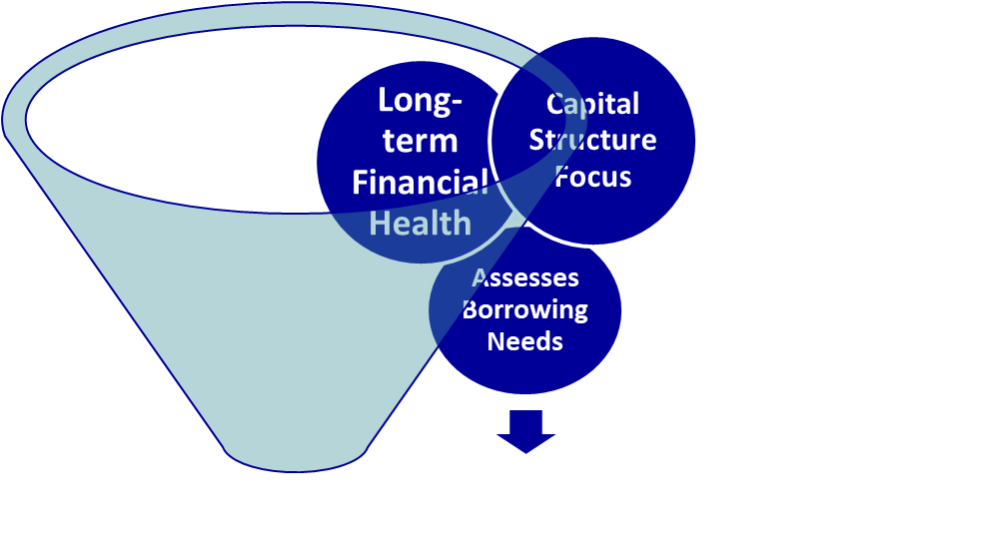
Solvency Ratios
Solvency focuses on capital structure and assesses the extent of borrowing needed.
Solvency refers to a company’s ability to remain in business over the long term.
Information being used for?

Slide 21
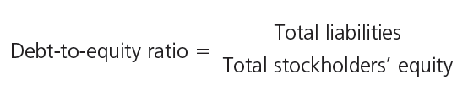
Debt-to-Equity Ratio

Slide 22
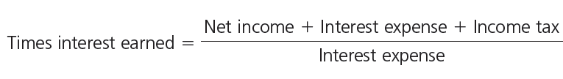
Times-Interest-Earned/Interest Coverage Ratio

Slide 23
PROFITABILITY & EFFICIENCY RATIOS
Profitability Ratios:
indicate how efficiently a venture controls its expenses
Efficiency Ratios:
indicate how efficiently a venture uses its assets in producing sales

Slide 24
MEASURING PROFITABILITY & EFFICIENCY
Gross Profit Margin:
= Net Sales – COGS
Net Sales

Slide 25
MEASURING PROFITABILITY & EFFICIENCY
Operating Profit Margin:
= EBIT .
Net Sales

Slide 26
MEASURING PROFITABILITY & EFFICIENCY
Net Profit Margin/Return on Sales(ROS):
= Net Profit
Net Sales

Slide 27
MEASURING PROFITABILITY & EFFICIENCY
Asset Turnover Ratio:
= Net Sales .
Ave total assets

Slide 28
MEASURING PROFITABILITY & EFFICIENCY
Return on Total Assets (ROA):
= Net profit .
Ave total assets

Slide 29
MEASURING PROFITABILITY & EFFICIENCY
ROA Model:
the decomposition of ROA into the product of the net profit margin and the sales-to-total-assets ratio
ROA
= (Net profit / sales) x (Net sales / Ave. total assets)

Slide 30
MEASURING PROFITABILITY & EFFICIENCY
Return on Equity (ROE):
= Net Income .
Ave owners’ equity

Slide 31
MEASURING PROFITABILITY & EFFICIENCY
ROE Model:
the decomposition of ROE into the product of the net profit margin, sales-to-total-assets ratio, and equity multiplier
ROE (or, Sustainable growth rate g)
= (Net profit / sales) x (Net sales / Ave. total assets) x (Ave. total assets / Ave. equity)
g = ROE x RR

Slide 32
Common Stock Ratios

Slide 33
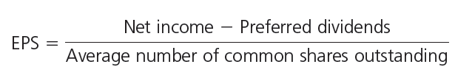
Earnings Per Share

Slide 34

Price Earnings Ratio

